Slide 1

Polymorphism and Abstraction
Having Multiple Forms
SoftUni Team
Technical Trainers
Software University
https://softuni.bg

Slide 2
Table of Contents
What is a Polymorphism?
Overloading Built-in Methods
Duck Typing
What is an Abstraction?
abc module
@abstractmethod
2
Notes:
2

Slide 3
Have a Question?
sli.do
#python-advanced
Notes:
3

Slide 4

What is a Polymorphism
Definition and Examples

Slide 5
Polymorphism Definition
Polymorphism is based on the Greek words "poly" (many) and "morphism" (forms)
It is the ability to present the same interface for differing underlying forms though the interface of their base class
e. g., Square and Triangle inherit Shape, so their instances can be used from an instance of type Shape

Slide 6
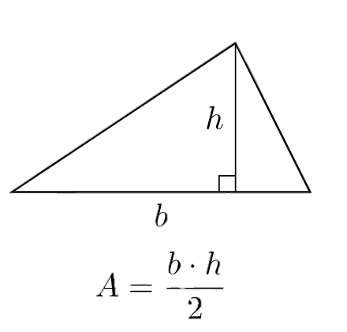
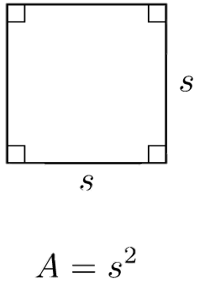
Run-Time Polymorphism
A subclass can override a method of its superclass
e. g., both triangle and square are shapes and have area

Slide 7
Example: Run-Time Polymorphism
class Shape:
def calculate_area(self):
return None
class Square(Shape):
side_length = 2
def calculate_area(self):
return self.side_length * 2
class Triangle(Shape):
base_length = 4
height = 3
def calculate_area(self):
return 0.5 * self.base_length * self.height
Overriding calculate_area method

Slide 8
Without Polymorphism
A type check may be required before performing an action on an object to determine the correct method to call
If not overriding calculate_area method
for obj in Square(), Triangle(): if isinstance(obj, Square): area = obj.calculate_square_area() elif isinstance(obj, Triangle): area = obj.calculate_triangle_area() print(area)

Slide 9
Compile-Time Polymorphism
Python does not support compile-time polymorphism or method overloading
If a class has multiple methods with the same name, the method defined in the last will override the earlier one
class Person:
def say_hello():
return "Hi!"
def say_hello():
return "Hello"
print(Person.say_hello()) # Hello

Slide 10

Problem: Robots
Refactor the provided code, so we do not need to do any type-checking. The classes should implement the method, so it returns the number of sensors for each type of robot.

Slide 11
Solution: Robots
class MedicalRobot(Robot):
@staticmethod
def sensors_amount():
return 6
class ChefRobot(Robot):
@staticmethod
def sensors_amount():
return 4
class WarRobot(Robot):
@staticmethod
def sensors_amount():
return 12
def number_of_robot_sensors(robot):
print(robot.sensors_amount())
basic_robot = Robot('Robo')
da_vinci = MedicalRobot('Da Vinci')
moley = ChefRobot('Moley')
griffin = WarRobot('Griffin')
number_of_robot_sensors(basic_robot)
number_of_robot_sensors(da_vinci)
number_of_robot_sensors(moley)
number_of_robot_sensors(griffin)

Slide 12
Overloading Built-in Methods

Slide 13
Overloading Built-in Methods
Change the behavior of functions such as len, abs, str, repr, and so on
To do this, you only need to define the corresponding special method in your class
class MyClass:
def __init__(self, name, size):
self.name = name
self.size = size
def __len__(self):
return self.size
my_class = MyClass("Class Name", 3)
print(len(my_class)) # 3

Slide 14
Operator Overloading
An operator behaves differently based on the type of the operands
e.g., operator "+" is used to add two integers as well as join two strings and merge two lists
It is overloaded by int class, str class and list class
integer = 1 + 1
string = "Hello, " + "SoftUni"
list = ["1", "2"] + ["3", "4"]

Slide 15
Operator Magic Methods
Magic Methods | Get Called Using
__add__(self, other) | +
__sub__(self, other) | -
__mul__(self, other) | *
__floordiv__(self, other) | //
__truediv__(self, other) | /
__pow__(self, other[, modulo]) | **

Slide 16
Example: Overloading __add__()
If we have a class Purchase and we want to sum all expenses using the + operator, we can override the __add__ method
class Purchase:
def __init__(self, product_name, cost):
self.product_name = product_name
self.cost = cost
def __add__(self, other): name = f'{self.product_name}, {other.product_name}' cost = self.cost + other.cost return Purchase(name, cost)
first_purchase = Purchase('sofa', 650)
second_purchase = Purchase('table', 150)
print(first_purchase + second_purchase) # sofa, table; 800

Slide 17
"Rich Comparison" Magic Methods
Magic Methods | Get Called Using
__lt__(self, other) | <
__le__(self, other) | <=
__eq__(self, other) | ==
__ne__(self, other) | !=
__gt__(self, other) | >
__ge__(self, other) | >=

Slide 18
Example: Overloading __gt__()
If we have a class Person and we want to compare them by their salary using the > operator, we can override the __gt__ method
class Person:
def __init__(self, name, salary):
self.name = name
self.salary = salary
def __gt__(self, other):
return self.salary > other.salary
person_one = Person('John', 20)
person_two = Person('Natasha', 36)
print(person_one > person_two) # False

Slide 19
Problem: Image Area
Create a class called ImageArea
It stores width and height of an image
Create a method called get_area() which returns the area of the image
Implement all the magic methods for comparison of two image areas (>, >=, <, <=, ==, !=) which will compare their areas

Slide 20
Solution: ImageArea
class ImageArea:
def __init__(self, width, height):
self.width = width
self.height = height
def get_area(self):
return self.width * self.height
def __eq__(self, other):
return self.get_area() == other.get_area()
# TODO: Implement the other comparison methods

Slide 21

Duck Typing

Slide 22
Duck Typing Definition
Duck Typing is a type system used in dynamic languages
"If it looks like a duck and quacks like a duck, it's a duck"
i.e., we don't care about objects' types, but whether they have the methods we need

Slide 23
Example: Duck Typing
We can create a method that calls the sound method, no matter of what the object which makes the sound is
class Cat:
def sound(self):
print("Meow!")
class Train:
def sound(self):
print("Sound from wheels slipping!")
for any_type in Cat(), Train():
any_type.sound()
Works for both classes

Slide 24
Problem: Playing
Create a method called start_playing which will receive an instance and will print its play() method if it has one
# Test Code
class Guitar:
def play(self):
return "Playing the guitar"
guitar = Guitar()
start_playing(guitar)
# Playing the guitar
# Test Code
class Children:
def play(self):
return "Children are playing"
piano = Children()
start_playing(piano)
# Children are playing

Slide 25
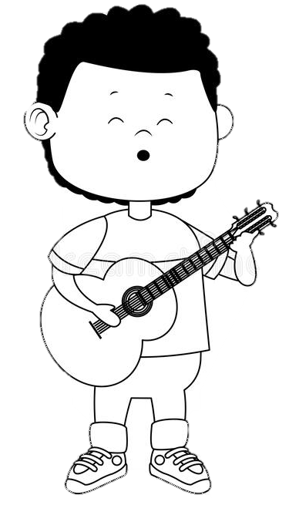
Solution: Playing
def start_playing(obj):
return obj.play()
# Test Code
class Guitar:
def play(self):
return "Playing the guitar"
guitar = Guitar()
start_playing(guitar)

Slide 26

What is an Abstraction
Definition and Examples

Slide 27
A Word about Abstraction
In object-oriented programming, abstraction is one of the four central principles
Through abstraction we hide all but the relevant data about an object to reduce complexity and increase efficiency
Abstraction can be achieved by:
Functions and methods
Abstract classes
27

Slide 28
Abstract Classes
Abstract classes are classes that contain one or more abstract methods
An abstract method is a method that is declared, but contains no implementation
Abstract classes may not be instantiated, and require subclasses to provide implementations for the abstract methods

Slide 29
Abstract Classes in Python
It could be achieved using exceptions, but it not a good practice
class Shape:
def __init__(self):
if type(self) is Shape:
raise Exception('This is an abstract class')
def area(self):
raise Exception('This is an abstract class')
def perimeter(self):
raise Exception('This is an abstract class')

Slide 30
Abstract Classes with ABC Module
Abstract base classes (ABCs) enforce derived classes to implement particular methods from the base class
We implement it using the abc module
class Shape:
def __init__(self):
if type(self) == Shape:
raise Exception('…')
def area(self):
raise Exception('…')
def perimeter(self):
raise Exception('…')
from abc import ABC, abstractmethod
class Shape(ABC):
@abstractmethod
def area(self):
pass
@abstractmethod
def perimeter(self):
pass

Slide 31
Example: Abstract classes (1)
from abc import ABC, abstractmethod
class Animal(ABC):
def __init__(self, name):
self.name = name
@abstractmethod
def sound(self):
raise NotImplementedError("Subclass must implement")
# Continues on next slide
Defining an Abstract Class
Makes a Method Abstract

Slide 32
Example: Abstract classes (2)
class Dog(Animal):
def __init__(self, name):
super().__init__(name)
def sound(self):
print("Bark!")
class Cat(Animal):
def __init__(self, name):
super().__init__(name)
def sound(self):
print("Meow!")
Inherit the Abstract Class
Implement the Abstract method
cat = Cat("Willy")
cat.sound()
dog = Dog("Willy")
dog.sound()
animal = Animal("Willy")
animal.sound()
# Meow!
# Bark!
# Error!

Slide 33
Problem: Shapes
Create an abstract class Shape with abstract methods calculate_area and calculate_perimeter
Create classes that implement the methods:
Circle - receives radius upon initialization
Rectangle - receives height and width upon initialization
The fields of Circle and Rectangle should be private

Slide 34
Solution: Shapes
from abc import ABC, abstractmethod
from math import pi
class Shape(ABC):
@abstractmethod
def calculate_perimeter(self):
pass
@abstractmethod
def calculate_area(self):
pass
# TODO: Implement Circle and Rectangle

Slide 35

Summary
Polymorphism means same function name being uses for different types
Through abstraction, we hide all but the relevant data about an object
Abstract classes may not be instantiated, and require subclasses
Notes:
35

Slide 36
Questions?
Notes:
36

Slide 37













SoftUni Diamond Partners

Slide 38


Educational Partners

Slide 39

License
This course (slides, examples, demos, exercises, homework, documents, videos and other assets) is copyrighted content
Unauthorized copy, reproduction or use is illegal
© SoftUni – https://about.softuni.bg
© Software University – https://softuni.bg
Notes:
39

Slide 40
Trainings @ Software University (SoftUni)
Software University – High-Quality Education, Profession and Job for Software Developers
softuni.bg, softuni.org
Software University Foundation
softuni.foundation
Software University @ Facebook
facebook.com/SoftwareUniversity
Software University Forums
forum.softuni.bg
Notes:
40

